Slide 1
Introduction to Android
STW300CEM Android Applications Development

Slide 2
Module Assessment
100% Assignment

Slide 3
Assessment
Individual based, not group work
Deadline : TBD
Assignment sheet on Moodle
Project should be uploaded in GitHub
Record your video:
ActivePresenter ( Windows) / Kazam (Linux)
QuickTime Player or any other video player

Slide 4
Module Expected outcomes
Requirements
Existing knowledge and programming experience
Outcomes
L01 Analysis the Android platform components and their uses.
L02 Design software suitable for android platform.
L03 Develop apps that can interact with web service APIs.
L04 Develop apps that can communicate with sensors built into the phone hardware.

Slide 5
Module Structure
Android Studio
The java language
XML and gradle
Simple Views and Controls
Composite View
Data persistence
Testing
Wearables
Graphics and animation

Slide 6

Weekly lab format
Previous worksheet ( demo )
New worksheet
Presentation by tutors on concepts and theory
Continue on new worksheet

Slide 7




Programming apps
Apps can be broadly classified into three distinct categories:
native apps, dedicated web apps, and hybrid apps.
Native applications are usually developed using higher level programming languages, such as Java for Android, Swift (Objective-C) for iOS.
Notes:
Hybrid app : easy to build ( angular , react native under that we have js , single app for all platform)

Slide 8
iOS or Android ?
Mobile users (till feb 2019)

Slide 9
Android is..
Android is an operating system and programming platform developed by Google for smartphones and other mobile devices (such as tablets). It can run on many different devices from many different manufacturers.
Android includes a software development kit for writing original code and assembling software modules to create apps for Android users. It also provides a marketplace to distribute apps.
All together, Android represents an ecosystem for mobile apps.

Slide 10
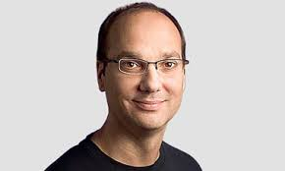
History
Android Inc. was founded in Palo Alto, California, in October 2003 by Andy Rubin, Rich Miner, Nick Sears, and Chris White. Rubin described the Android project as "tremendous potential in developing smarter mobile devices that are more aware of its owner's location and preferences".
In 2005, the next big chapter in Android’s history was made when the original company was acquired by Google.
In late 2014, Rubin left Google altogether and launched a startup business incubator.
Earlier in 2017, Rubin officially revealed his return to the smartphone industry with his company’s announcement of the Android-based Essential Phone.

Slide 11
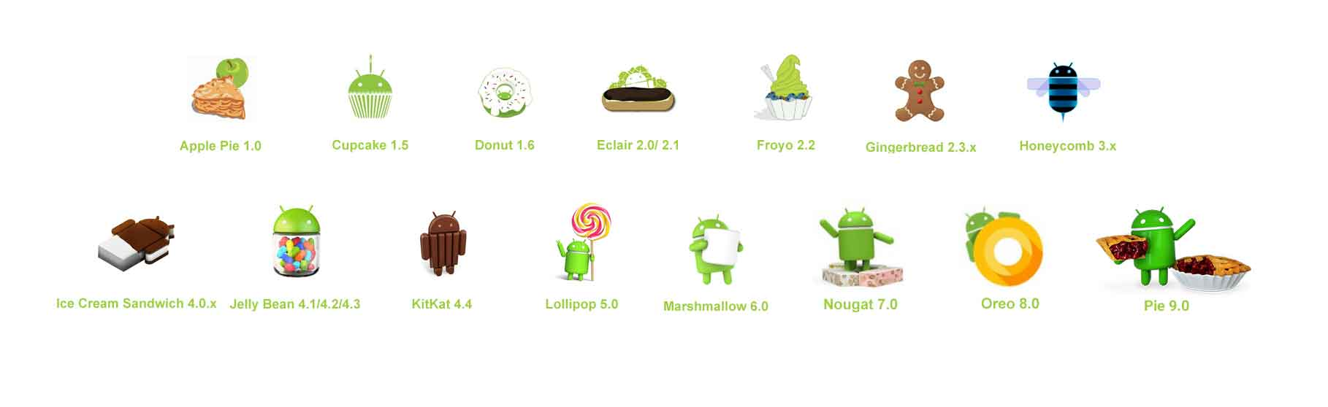
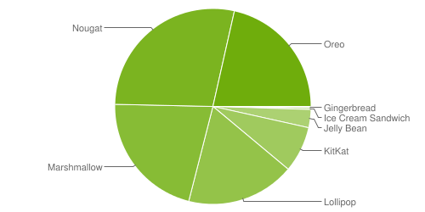
Android Versions

Slide 12
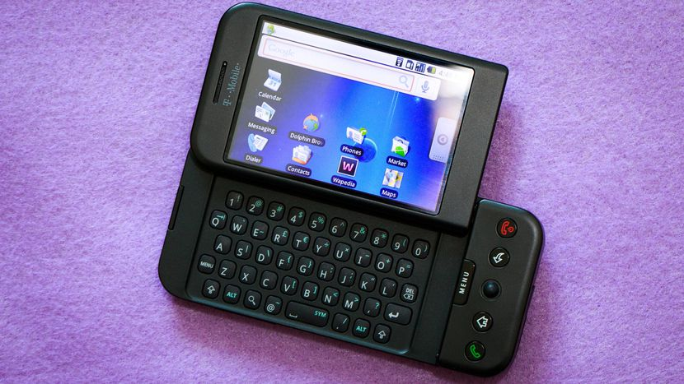
First Android Phone
First android phone was launched by HTC on 22nd October 2008.
HTC Dream which is also known as the T-Mobile G1 in the United States of America and some parts of Europe is the first commercially launched device to be powered by Android operating system

Slide 13
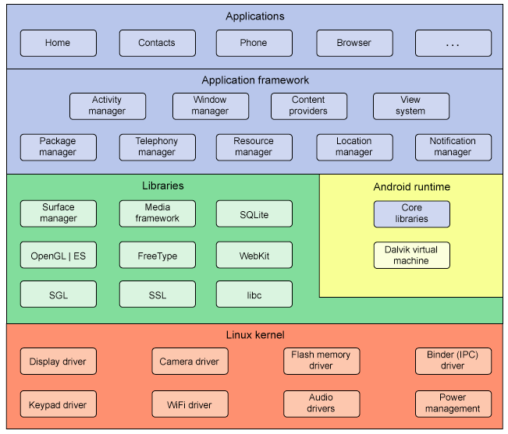
Android architecture

Slide 14
Android architecture
Linux kernel
This provides a level of abstraction between the device hardware and it contains all the essential hardware drivers like camera, keypad, display etc. Also, the kernel handles all the things that Linux is really good at such as networking and a vast array of device drivers, which take the pain out of interfacing to peripheral hardware.
Libraries
On top of Linux kernel there is a set of libraries including open-source Web browser engine WebKit, well known library libc, SQLite database which is a useful repository for storage and sharing of application data, libraries to play and record audio and video, SSL libraries responsible for Internet security etc.
Android Runtime
This is the third section of the architecture and available on the second layer from the bottom. This section provides a key component called Dalvik Virtual Machine which is a kind of Java Virtual Machine specially designed and optimized for Android. The Dalvik VM makes use of Linux core features like memory management and multi-threading, which is intrinsic in the Java language. The Dalvik VM enables every Android application to run in its own process, with its own instance of the Dalvik virtual machine. The Android runtime also provides a set of core libraries which enable Android application developers to write Android applications using standard Java programming language.

Slide 15
Android architecture
4. Application Framework
The Application Framework layer provides many higher-level services to applications in the form of Java classes. Application developers are allowed to make use of these services in their applications.
The Android framework includes the following key services −
Activity Manager − Controls all aspects of the application lifecycle and activity stack.
Content Providers − Allows applications to publish and share data with other applications.
Resource Manager − Provides access to non-code embedded resources such as strings, color settings and user interface layouts.
Notifications Manager − Allows applications to display alerts and notifications to the user.
View System − An extensible set of views used to create application user interfaces.
5. Applications
You will find all the Android application at the top layer. You will write your application to be installed on this layer only. Examples of such applications are Contacts Books, Browser, Games etc.

Slide 16
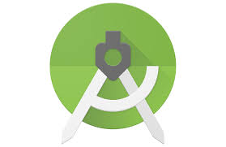
IDE
Android Studio is an official IDE for developing android applications
Free and Simple
Open Source
Written in java
Integrated gradle build system

Slide 17
Setting up IDE
To be an Android developer, you need
Android Studio , which in turn contains
Android SDK (tools, platform-tools/build-tools)
A version of the Android platform
A version of the Android system image for the emulator
Other tools (usb drivers etc.)

Slide 18
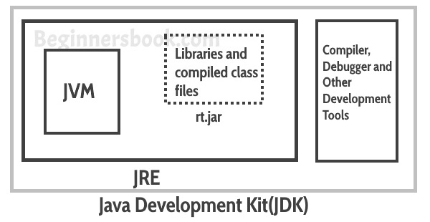
Step 1: Install java
Choose JDK
Java Development Toolkit
Contains complete JRE
Compilers
Debuggers
Not JRE
Java Runtime Environment
Libraries
Java Virtual Machine
Components to run applets

Slide 19
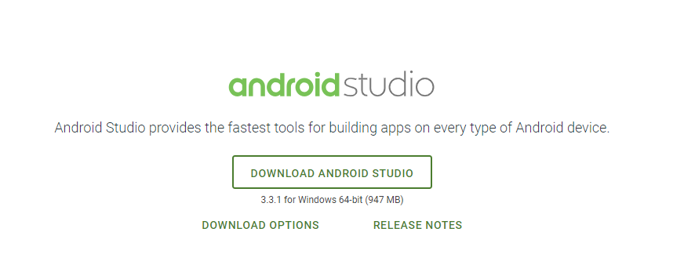
Step 2 : Install Android Studio
https://developer.android.com/studio/

Slide 20
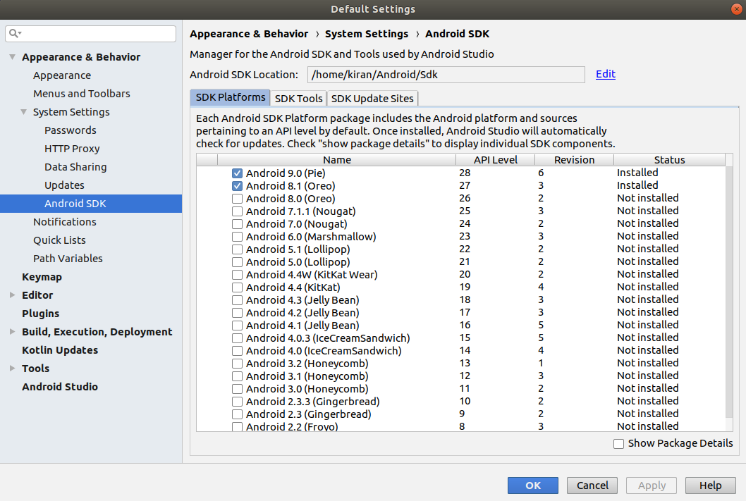
Step 3 : Update SDK
To open SDK Manager: Android Studio -> Tools -> SDK Manager

Slide 21
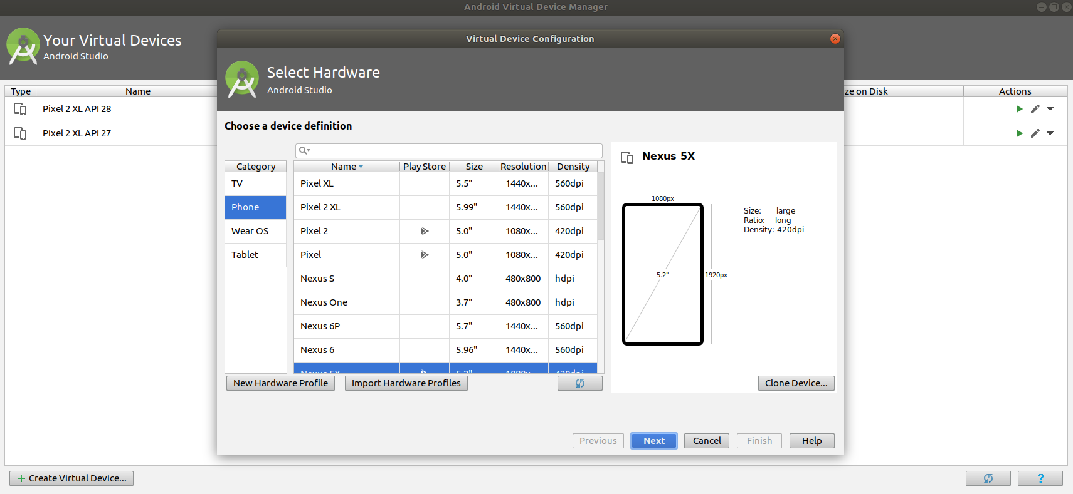
Step 4 : Create AVDs ( Android virtual devices)
To open SDK Manager: Android Studio -> Tools -> AVD Manager

Slide 22
Step 5 : Testing device
Enable USB debugging on your device.
Set up your system to detect your device
Enable debug mode
Setup your computer i.e. install drivers etc.
depends on your computer/phone
Check here
https://developer.android.com/studio/run/device.html

Slide 23
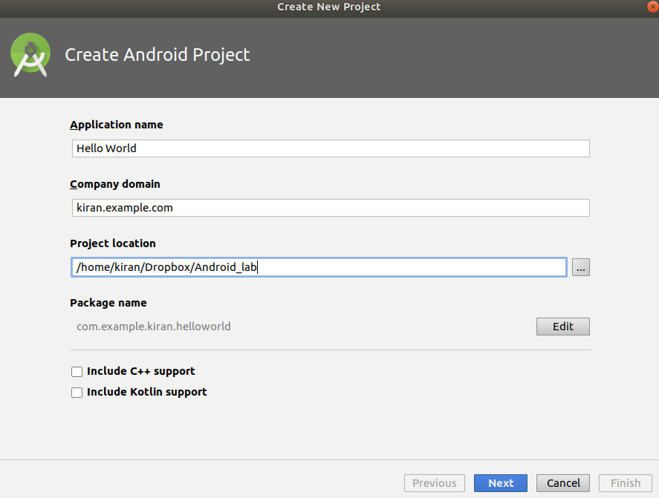
First Android app
Application name is the app name that appears to users.
Company domain provides a qualifier that will be appended to the package name. Android Studio will remember this qualifier for each new project you create
Package Name is the package namespace for your app (as packages in the Java).

Slide 24
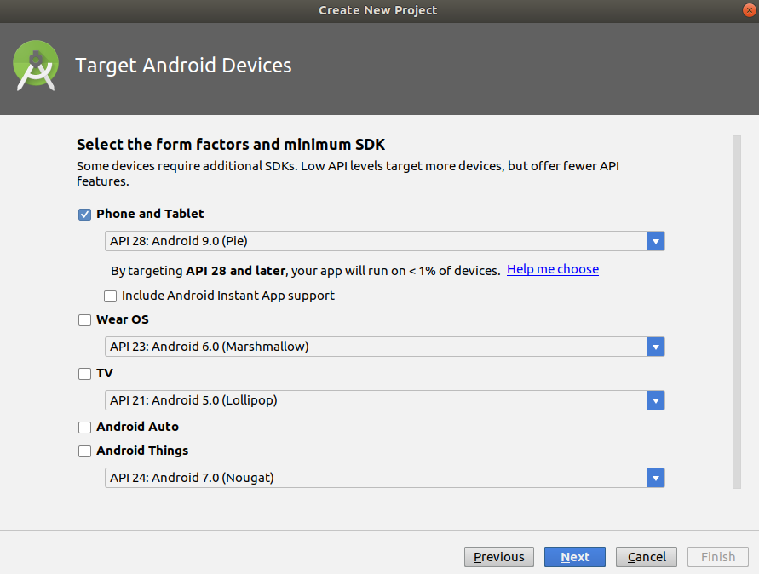
First Android app

Slide 25
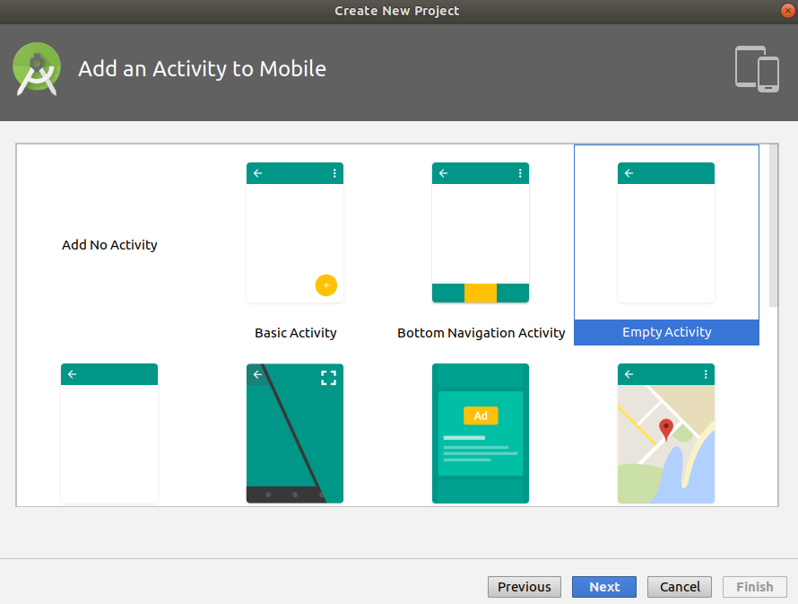
First Android app

Slide 26
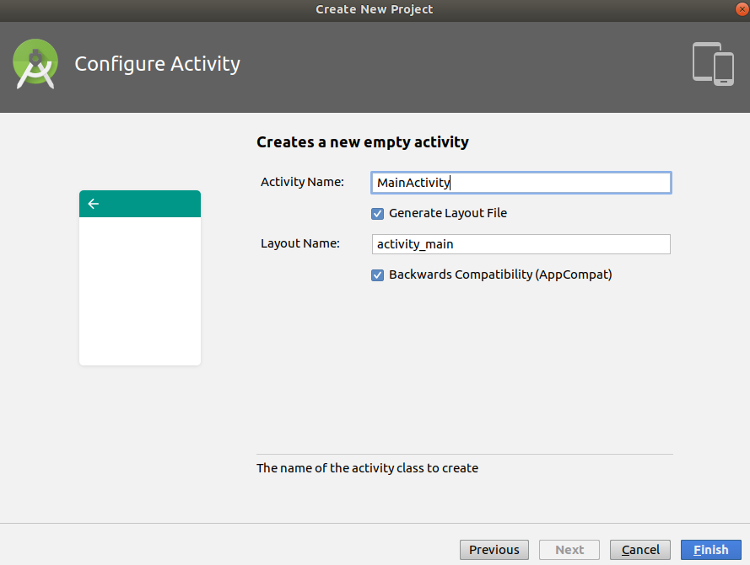
First Android app

Slide 27
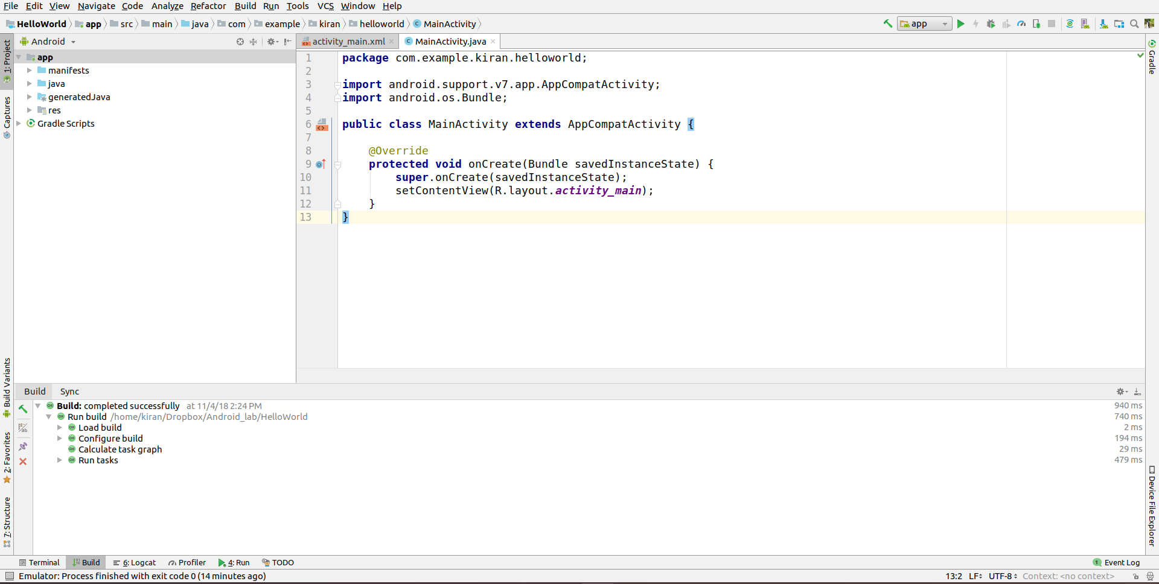
Running android app
Click here to run android app

Slide 28
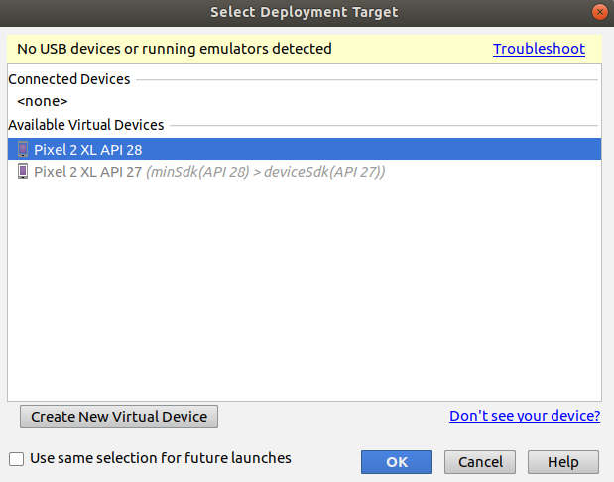
First Android app
Select the virtual device
Or
The testing device

Slide 29
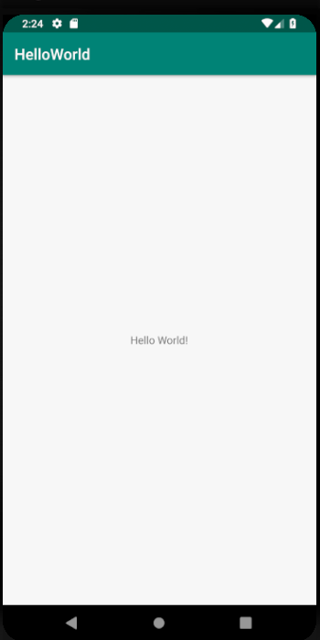
Output

Slide 30
build.gradle
Gradle is a build system (open source) which is used to automate building, testing, deployment etc. “Build.gradle” are scripts where one can automate the tasks.
For example, the simple task to copy some files from one directory to another can be performed by Gradle build script before the actual build process happens.
Every Android project needs a gradle for generating an apk from the .java and .xml files in the project.
Simply put, a gradle takes all the source files (java and XML) and apply appropriate tools, e.g., converts the java files into dex files and compresses all of them into a single file known as apk that is actually used.

Slide 31
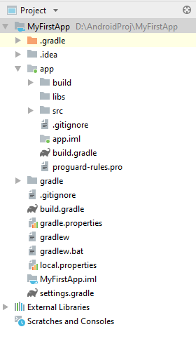
Types of build.gradle scripts
There are two types of build.gradle scripts
1. Top-level build.gradle
2. Module-level build.gradle

Slide 32
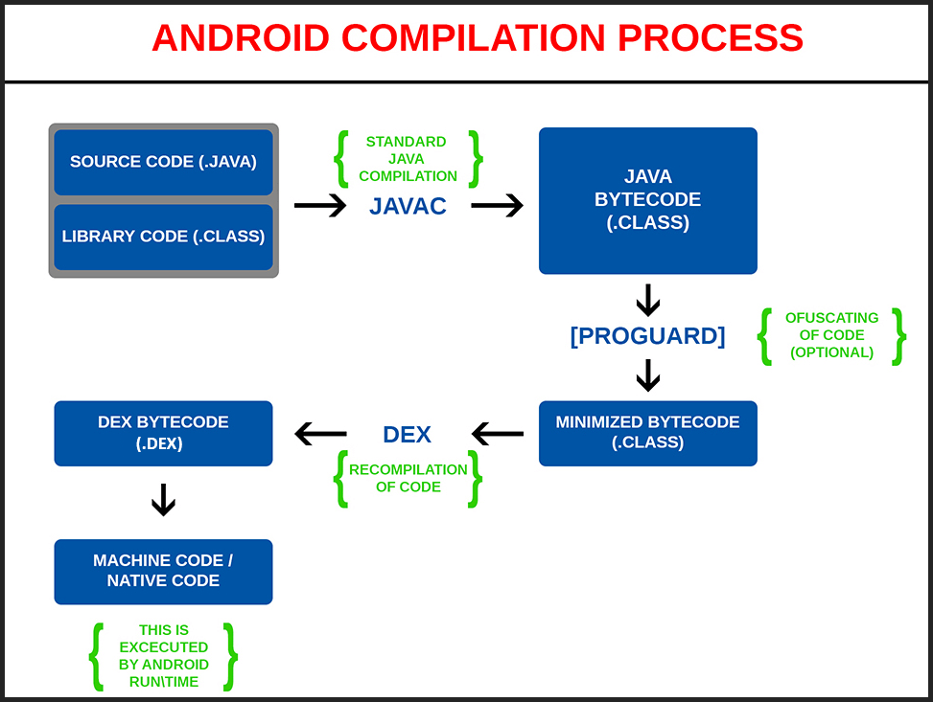
Android Compilation Process
Notes:
for Android, we have two different virtual machines:
DEX ( Dalvik executable file)
1. DALVIK : uses just in time
2. ART : ahead of time
It also has improved garbage collection so that the user sees fewer pauses and stutters in a low memory environment.
Ofuscating (tool is named as ProGuard) : removing unnesseary code (e.g unused function , variables etc) . Bydefault it is disabled in android studio.
DEX ( Dalvik EXcetuable) : The DEX bytecode is a format that is optimized for Android and which can be executed by the older DALVIK runtime or the newer ART runtime.

Slide 33
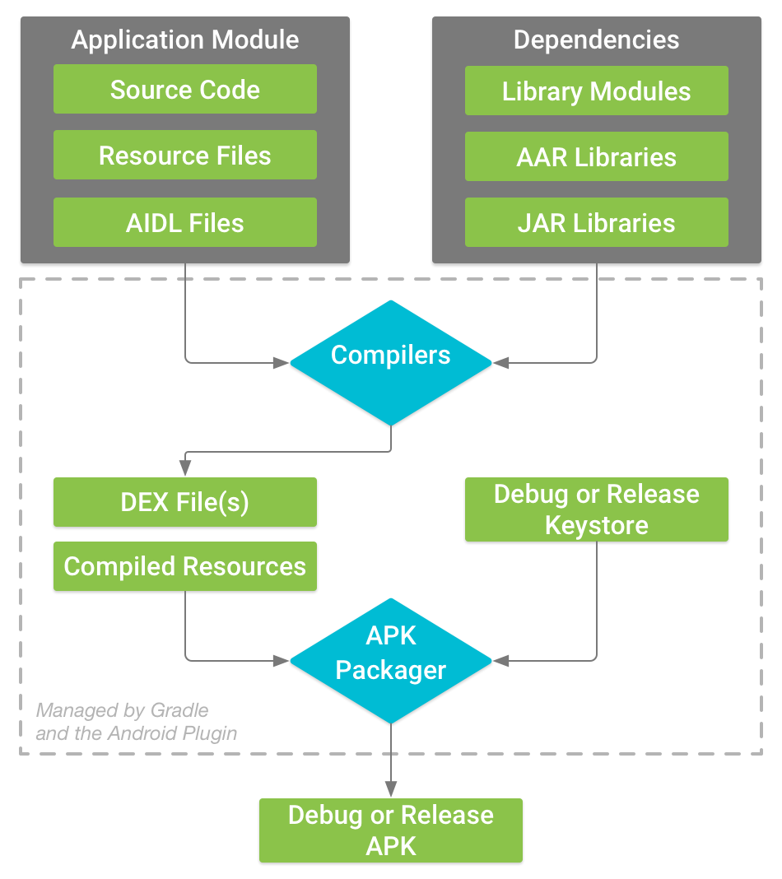
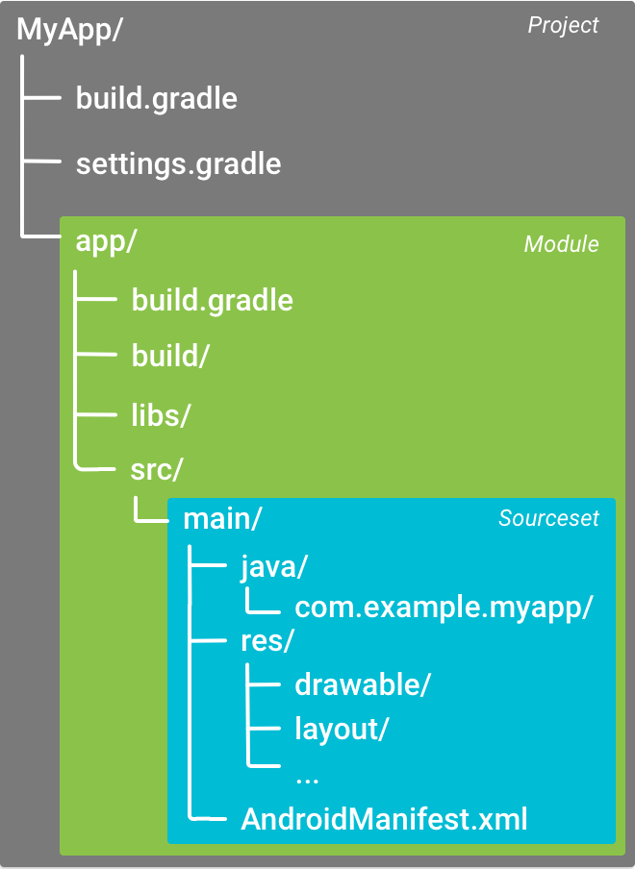
The build process
Notes:
The build process involves many tools and processes that convert your project into an Android Application Package (APK). The build process is very flexible, so it's useful to understand some of what is happening under the hood.
AAR : Android Archive format

Slide 34
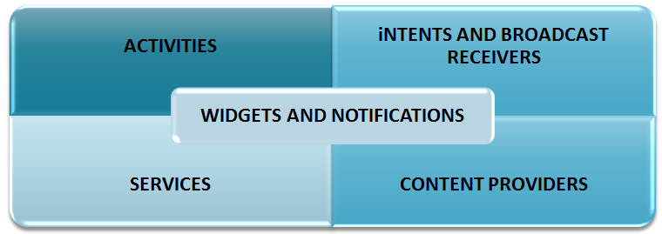
Basic Parts of Android Application

Slide 35
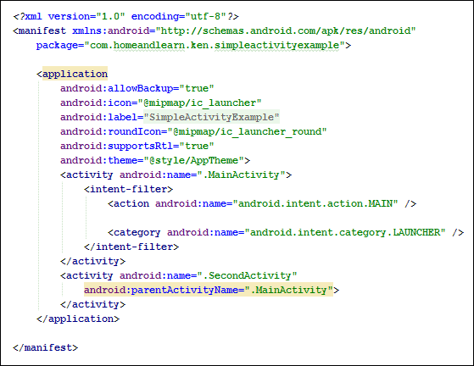
The Android Manifest.xml File
Every application must have an AndroidManifest.xml file (with precisely that name) in its root directory. The manifest presents essential information about the application to the Android system, information the system must have before it can run any of the application's code. Among other things, the manifest does the following:
It names the Java package for the application. The package name serves as a unique identifier for the application.
It describes the components of the application — the activities, services, broadcast receivers, and content providers that the application is composed of.
It declares which permissions the application must have in order to access protected parts of the API and interact with other applications.
It determines which processes will host application components.

